Slide 1


Nikita Grabovskiy
05/12/2023

Slide 2

Outline
Executive Summary
Introduction
Methodology
Results
Conclusion
Appendix

Slide 3
Executive Summary
Methodologies:
Data Collection
Data Wrangling
EDA with Data visualization
EDA with SQL
Build interactive map with Folium
Build a dashboard with Plotly Dash
Predictive analysis (Classification)
Summary of all results :
Exploratory data analysis results
2. Interactive analytics demo in screenshots
3. Predictive analysis results

Slide 4
Introduction
Project background and context:
This is a data science project for Space Y company which planning to compete with Space X in commercial rocket launching.
Problems you want to find answers:
Determine cost of each Space X launch and creating dashboards for team.
Determine if Space X. will reuse the first stage.

Slide 5

Section 1

Slide 6
Methodology
Executive Summary
Data collection methodology:
With Space X rest API and Web scrapping from Wikipedia
Perform data wrangling
Data cleaning from empty values and unused columns and one hot encoded to use it fro Machine learning
Perform exploratory data analysis (EDA) using visualization and SQL
Perform interactive visual analytics using Folium and Plotly Dash
Perform predictive analysis using classification models
LR, KNN,SVM,DT models have been build and evaluated for the best classification performance

Slide 7
Data Collection
The following data sets were collected :
Space X launch date gathered from SpaceX API (https://api.spacexdata.com/v4). It includes launces information such as rocket type, payload delivered, launch details and landing outcome.
2. Falcon 9 launch data has been collected from Wikipedia.

Slide 8
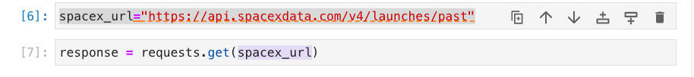
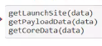
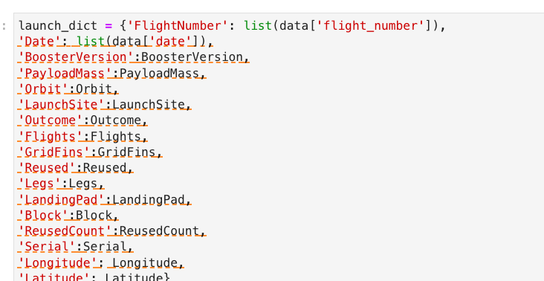
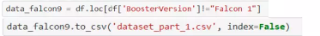
Data Collection – SpaceX API
Call SpaceX api
2 . Convert response to json format
4. Convert list to dataframe
3. Clear data
5. Filter Data frame and export .cvs

Slide 9
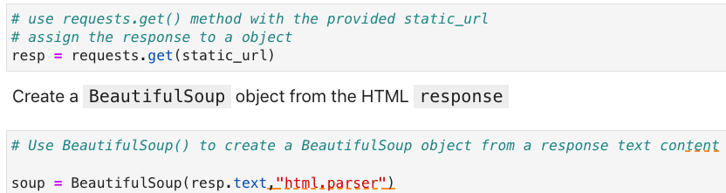
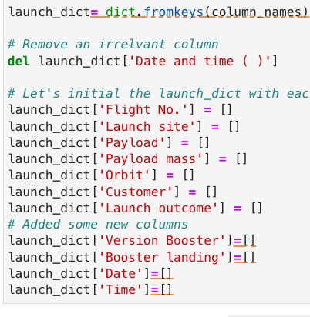
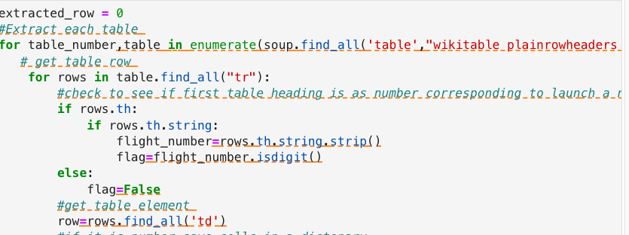
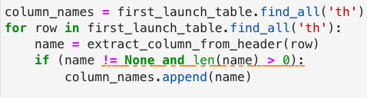
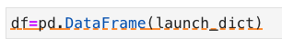
Data Collection – Scraping from Wikipedia
Getting response from HTML and creating BeautifulSoup object from it
4. Creating directory
2. Finding tables
3. Getting column names
5. Appending data to keys
Converting dataframe to .CSV

Slide 10
Check for null values
Calculate the number of launches on each site
Calculate the number and occurrence of each orbit
Calculate the number and occurrence of mission outcome per orbit type
Create a landing outcome label from Outcome
Handle null values
Data Wrangling

Slide 11
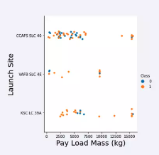
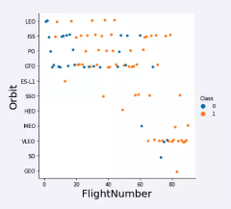
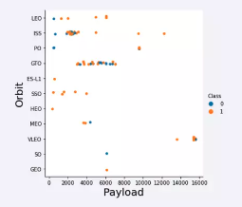
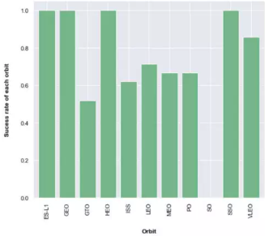
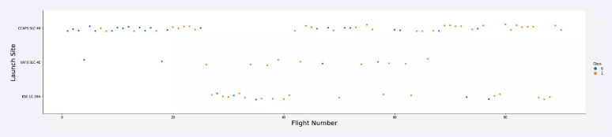
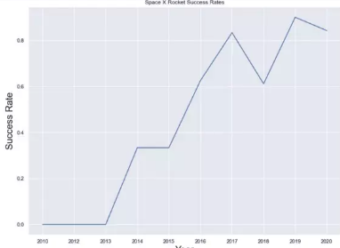
EDA with Data Visualization
Year

Slide 12
EDA with SQL
SQL Queries performed:
Display names of unique launch sites in the space mission
Display 5 records where launch sites begin with the string "CCA"
Display the total payload mass carried by boosters launched by NASA (CRS)
Display average payload mass carried by booster version F9 v1.1
List the date when the first succesful landing outcome in ground pad was acheived
List the names of the boosters which have success in drone ship and have payload mass greater than 4000 but less than 6000
List the total number of successful and failure mission outcomes
List the names of the booster_versions which have carried the maximum payload mass
List the records which will display the month names, failure landing_outcomes in drone ship ,booster versions, launch_site for the months in year 2015.
Rank the count of successful landing_outcomes between the date 04-06-2010 and 20-03-2017 in descending order.

Slide 13
Build an Interactive Map with Folium
folium.Maker() has been used to create marks on the map
folium.Circle() has been used to create a circle above markers on the map
folium.Icon() has been used to create an icon on the map
folium.PolyLine() has been used to create plynomial line between the points
folium.plugins.AntPath() has been used to create animation line between the points
MakerCluster() has been used to simplify the maps which contain several markers with identical coordination

Slide 14
Predictive Analysis (Classification)
Build the model
Create column for the class
Standardize the data
Splite data into train and testing sets
Build GridServicCV model and fit the data
Evaluate the model
Calculate the accuracies
Calculate the confusion amtrixes
Plot the results
Find the optimal model
Find hyperparameters for the model with the best accuracy

Slide 15
Results
SVM, KNN and logistic regression models are the best for prediction accuracy for this dataset.
The success rates for the Space X launces improves with time
Low weighted payloads more successful than heavier payloads
KSC LC 39A has the most successful launches from all the sites
Orbit GEO, HEO,SSO,ES L1 has the best success rate

Slide 16

Section 2

Slide 17
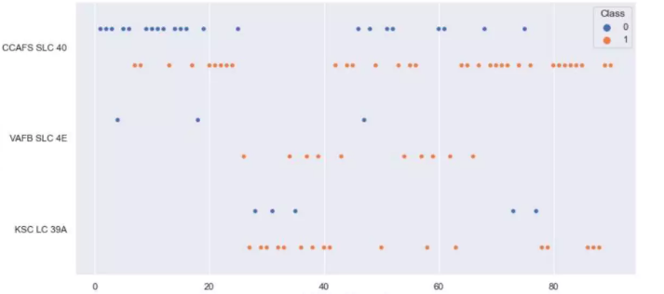
Launch Site
Flight Number vs. Launch Site
Flight number
Number of launches from the CAFS SLC 40 site are higher than launches from the other sites.

Slide 18
Launch Site
Payload vs. Launch Site
Most of the payloads with lower mass have been launched from CCAFS SLC 40 site.
Most of the payloads with higher mass have been lauched from VAFB SLC 4E site.
Pay load mass

Slide 19
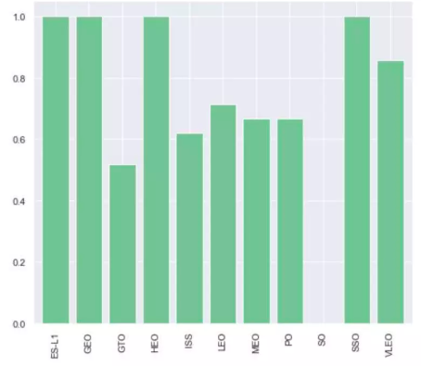
Success Rate vs. Orbit Type
ES-L1,GEO,HEO,SSO have the highest success rate
Success Rate
Orbit type

Slide 20
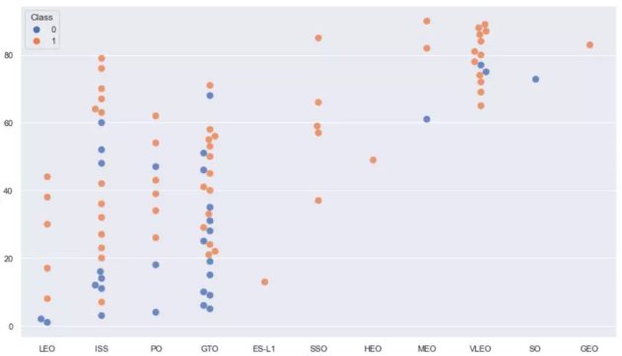
Flight Number vs. Orbit Type
Orbit Type

Slide 21
Flight Number vs. Orbit Type
Orbit Type

Slide 22
Flight Number vs. Orbit Type
Orbit Type

Slide 23
Flight Number vs. Orbit Type
Orbit Type

Slide 24
Flight Number vs. Orbit Type
SSO, HEO, MEO, SO, GEO has the lowest amount of flights
Flight number
Orbit Type

Slide 25
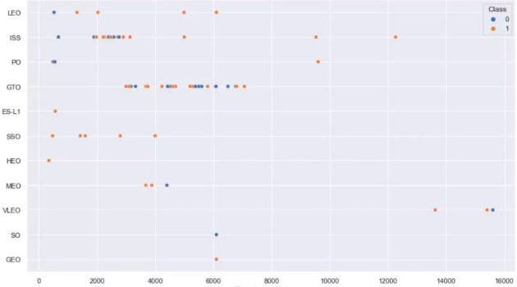
Orbit type
Payload vs. Orbit Type
There is a correlation between ISS and Payload at the range from 200 to 4000 and between GTO and range from 3000 and 7000
Payload

Slide 26
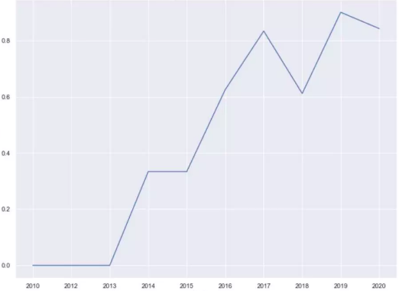
Launch Success Yearly Trend
The success rate increases with time
Launch Success
Year

Slide 27
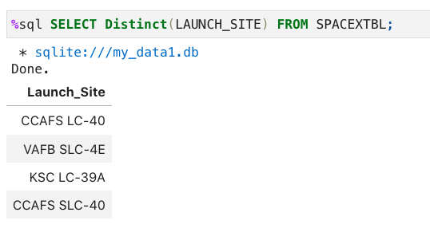
All Launch Site Names

Slide 28
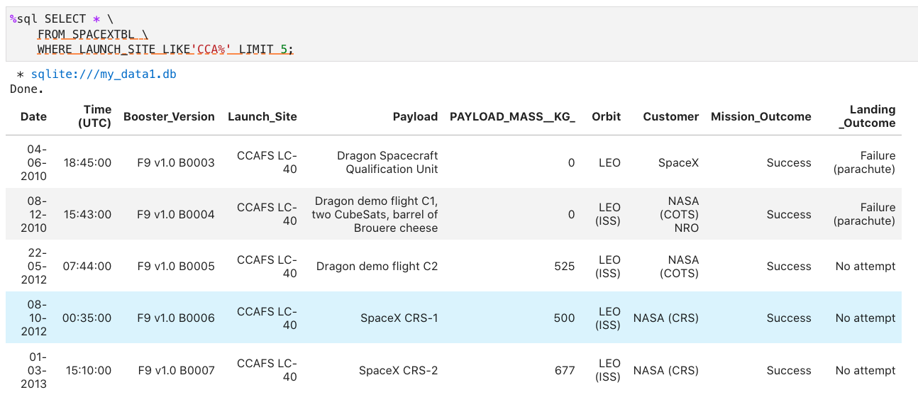
Launch Site Names Begin with 'CCA'

Slide 29
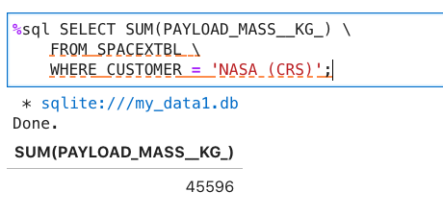
Total Payload Mass

Slide 30
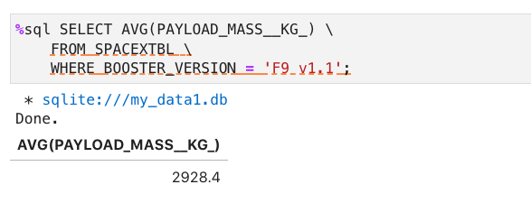
Average Payload Mass by F9 v1.1

Slide 31
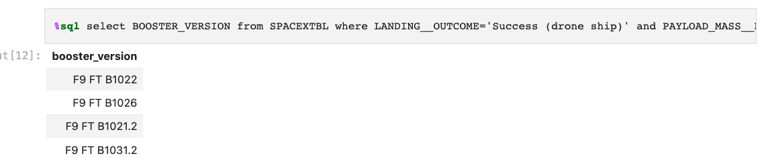
Successful Drone Ship Landing with Payload between 4000 and 6000

Slide 32
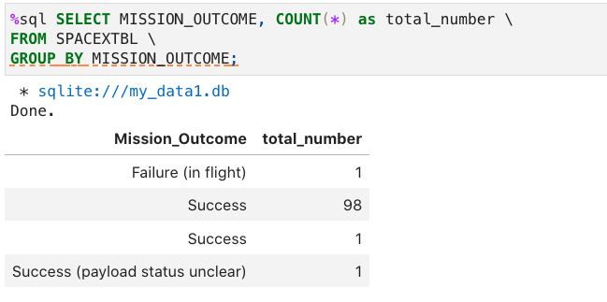
Total Number of Successful and Failure Mission Outcomes

Slide 33
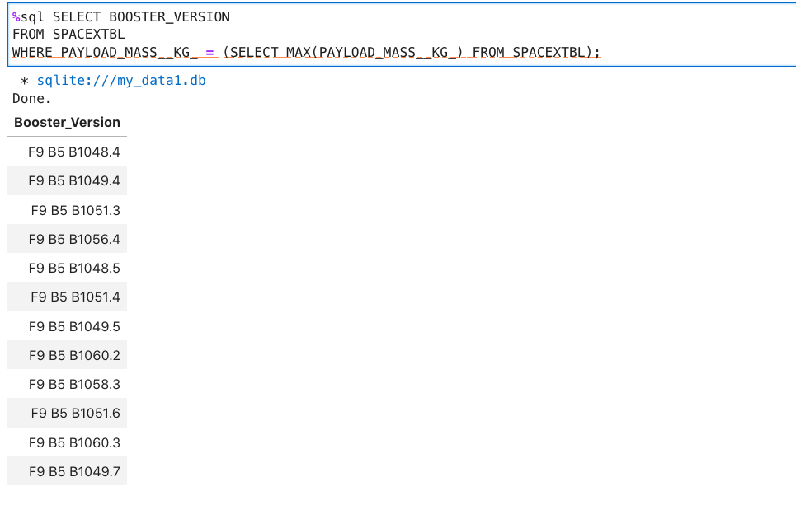
Boosters Carried Maximum Payload

Slide 34
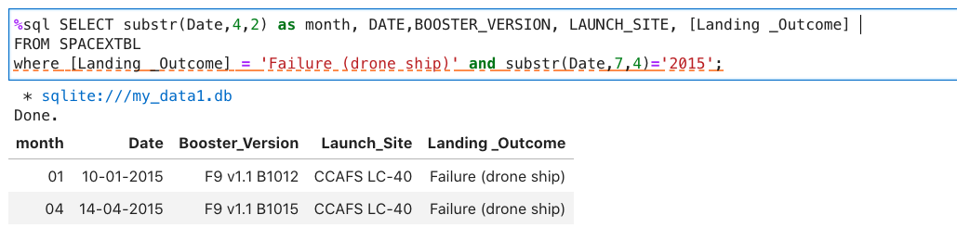
2015 Launch Records

Slide 35
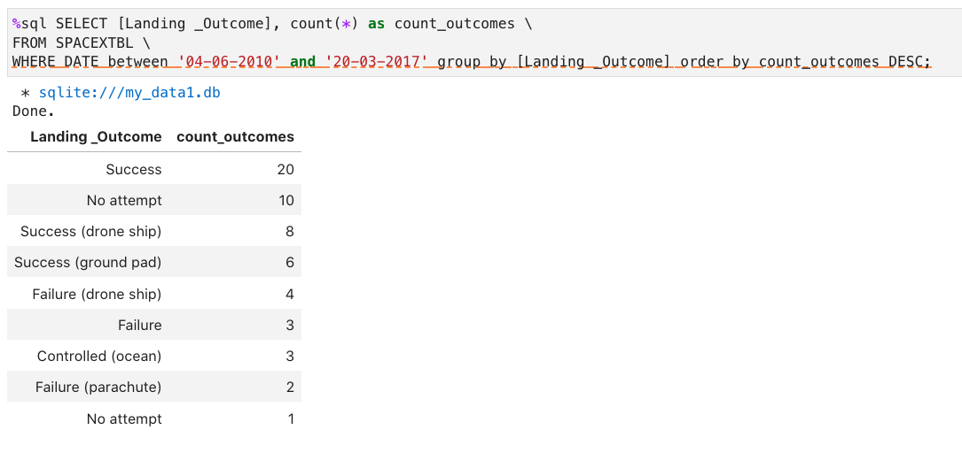
Rank Landing Outcomes Between 2010-06-04 and 2017-03-20

Slide 36

Section 3

Slide 37
<Folium Map Screenshot 1>
Replace <Folium map screenshot 1> title with an appropriate title
Explore the generated folium map and make a proper screenshot to include all launch sites’ location markers on a global map
Explain the important elements and findings on the screenshot

Slide 38
<Folium Map Screenshot 2>
Replace <Folium map screenshot 2> title with an appropriate title
Explore the folium map and make a proper screenshot to show the color-labeled launch outcomes on the map
Explain the important elements and findings on the screenshot

Slide 39
<Folium Map Screenshot 3>
Replace <Folium map screenshot 3> title with an appropriate title
Explore the generated folium map and show the screenshot of a selected launch site to its proximities such as railway, highway, coastline, with distance calculated and displayed
Explain the important elements and findings on the screenshot

Slide 40

Section 4

Slide 41
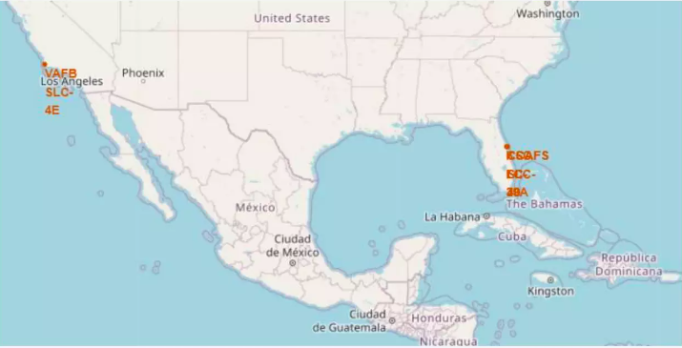
Launches sites

Slide 42
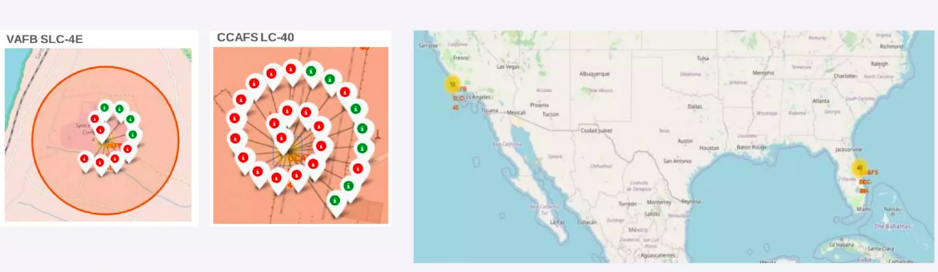
Color-labeled launch outcomes
Green – successful
Read - failed

Slide 43

Section 5

Slide 44
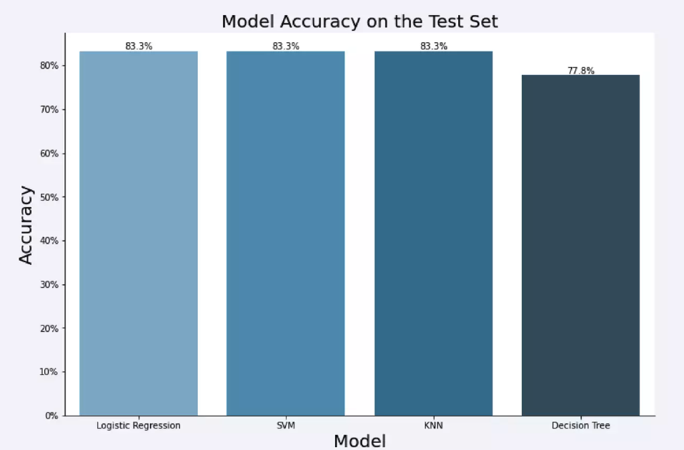
Classification Accuracy

Slide 45
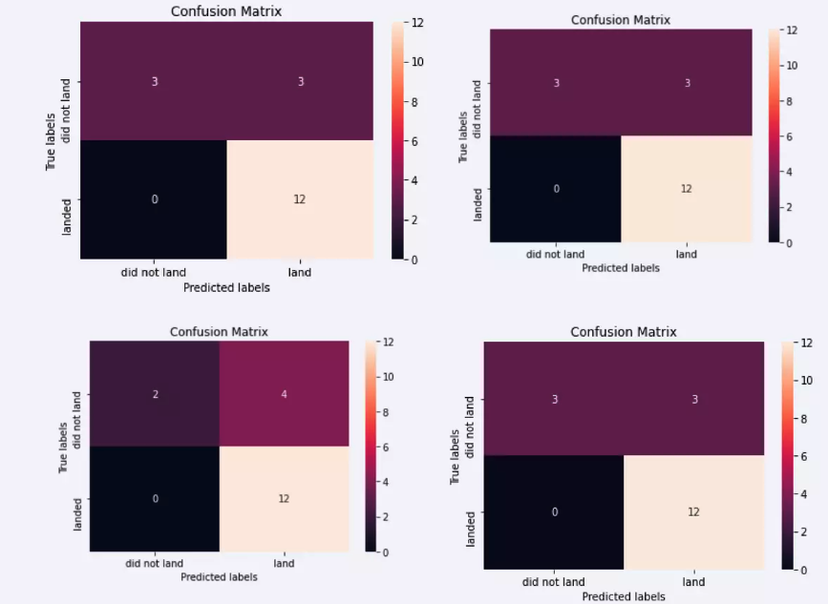
Confusion Matrix

Slide 46
Conclusions
We found that the launching site with the highest score is KSC LC-39A
Low weighted payloads have better success rate than heavy payloads.
The SVM, KNN and logistic Regression models are the best in terms of prediction accuracy for this dataset.
Orbits GEO, HEO,SSO,ES L1 have the test success Rate.

Slide 47


